Slide 1
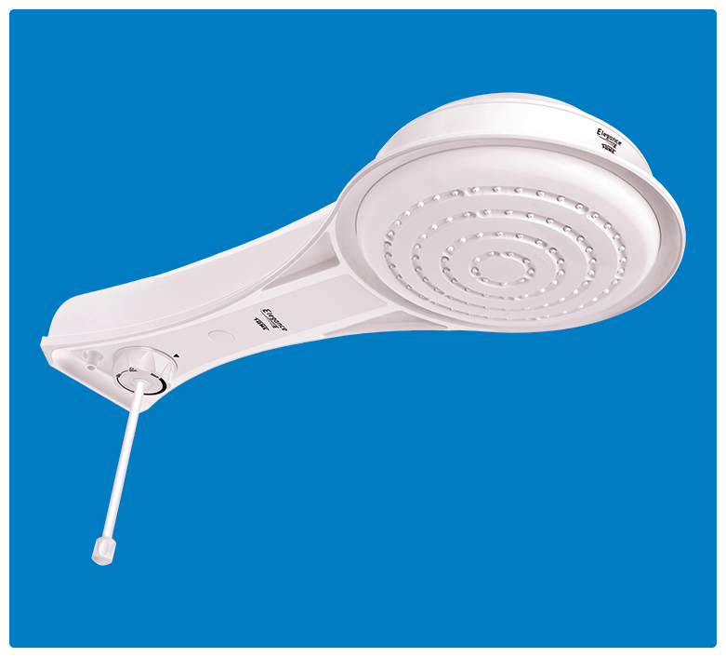
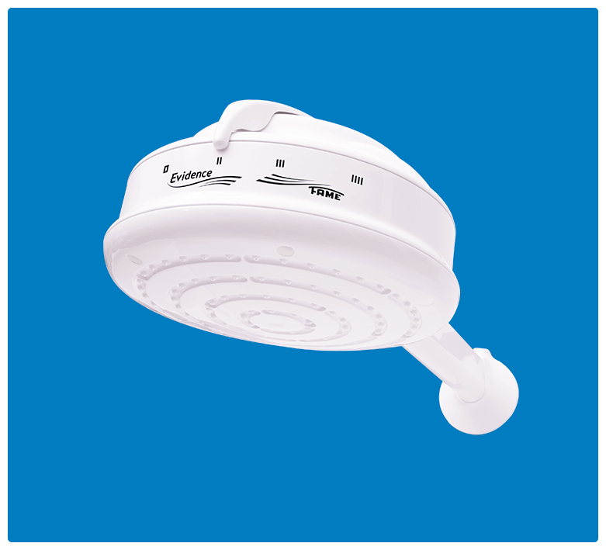
FAME INSTANT HOT SHOWER
@5,500/-
- Free delivery within Nairobi
- Free Site evaluation/advisory on Purchase
- Turnkey Package available – delivery, installation & commissioning
ELEGANCE ELECTRONIC
Contact:
Purity – xxxxxxxxx
Email – XXXXXXXXX
Visit: www.linkage-africa.com
DUCHA EVIDENCE
@3,800/-

Slide 2
Fame instant hot shower
DUCHA EVIDENCE
@3800
@5500

